Slide 1
Web scraping Project
An analysis on the whey protein market

Slide 2
Whey Protein Powder - an essential product in the supplement market
Popular among athletic crowds for its convenience
A relatively cheap source of protein
Smaller carbon footprint compared to meat products

Slide 3
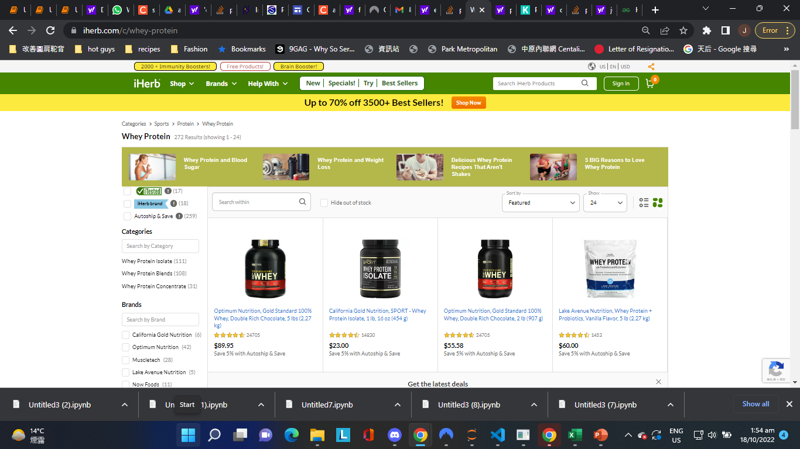
Target website - iHerb
An international online retailer
A big player in the supplement market

Slide 4
What makes a whey protein product more popular than the rest?
Using the number of reviews a product has on the website, we will explore the factors behind their popularity:
Customer Satisfaction
Price
Flavours

Slide 5
Step 1: Scraping all products under the Whey Protein category
Data collected:
Product titles
Prices
Rating (number of stars out of 5)
Number of reviews

Slide 6
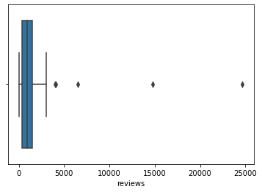
Step 2: Find Outliers with box plot

Slide 7
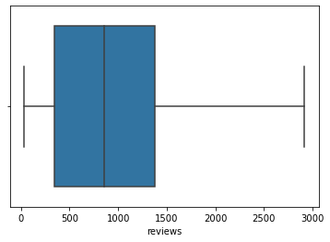
Step 2.5: Remove Outliers

Slide 8
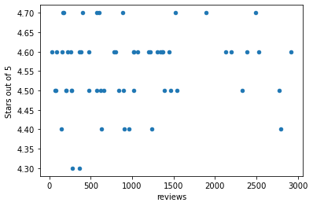
Step 3: Data Analysis
- User satisfaction and Popularity
No indication there is a relation between the two.

Slide 9
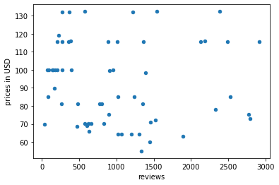
Step 4: Data Analysis
- Price and Popularity (How price-sensitive are the customers?)
No indication that the customers are particularly price-sensitive.

Slide 10
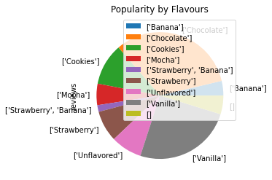
Step 4: Data Analysis
- Flavours and Popularity

Slide 11
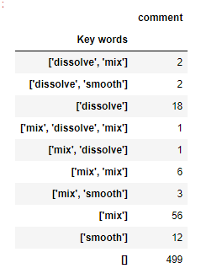
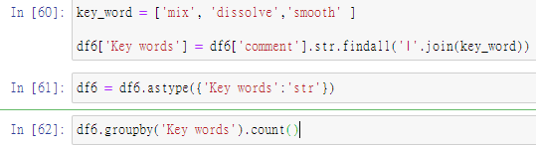
Step 5: Data Analysis
- Comment section of the top 7 best sellers
Key words about solubility | frequency
mix | 66/600
dissolve | 24/600
smooth | 12/600
Number of reviews that contain any of the above key words | 101/600

Slide 12
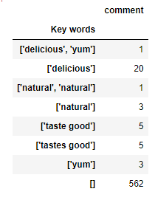
Step 5: Data Analysis
- Comment section of the top 7 best sellers
Key words about taste | frequency
delicious | 21/600
yum | 4/600
natural | 4/600
Taste/tastes good | 10/600
Number of reviews that contain any of the above key words | 38/600

Slide 13
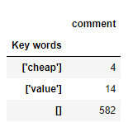
Step 5: Data Analysis
- Comment section of the top 6 best sellers
Key words about value for money | frequency
cheap | 4/600
value | 14/600
Number of reviews that contain any of the above key words | 18/600

Slide 14
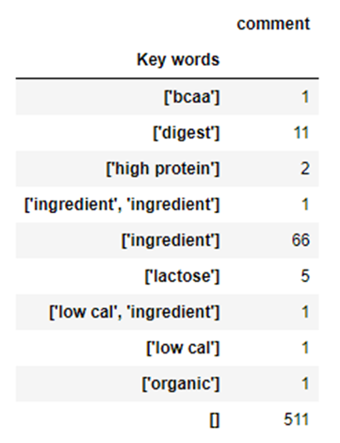
Step 5: Data Analysis
- Comment section of the top 7 best sellers
Key words about nutrition information | frequency
ingredient | 67/600
digest | 11/600
lactose | 5/600
Low cal/high protein | 4/600
Number of reviews that contain any of the above key words | 89/600

Slide 15
Conclusion:
The most significant factors that play an important role in customers’ buying decision: flavour and texture
Prices do not seem to be a priority of the customers probably due to the demography of the customers and because the price per serving remain low.

Slide 16
Challenges and Limitation
analysis of the comment section proves to be challenging

Slide 17
THE END

